Slide 1
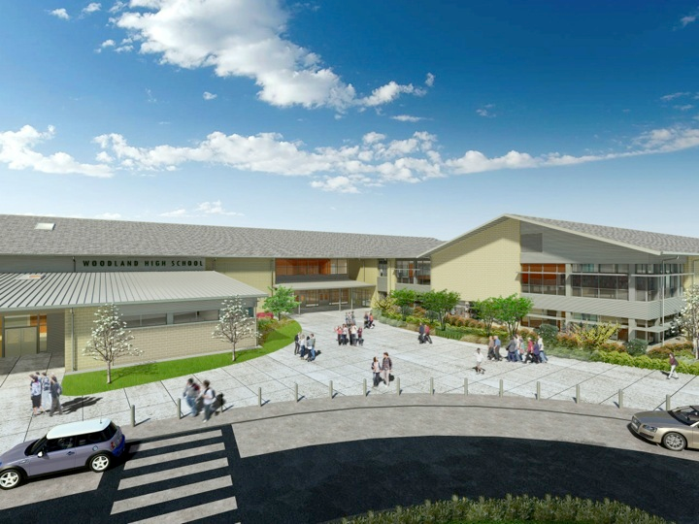
Woodland Public Schools
Facilities and Safety Report
March 2018

Slide 2
FACILITIES REPORT
ALICE Training The Admin team overwhelming supported initiating ALICE training at all of the schools. Regardless if the training would be viable if a school emergency existed, the team supported training school staff to empower the employees to make decisions and think outside of the box. I will arrange this training for the Admin Team before the beginning of the 18-19 school year.
Solar System, Inching Forward Solar World of Oregon has done a reorganization since the beginning of the year, which has made it difficult to gain steady progress on this project. They have finally sent the MOU for the system they are supplying. Once they receive the MOU back from the District, we will issue a PO for the panels. They are also currently looking at the other support items, to see what discounts they can apply to them. (inverters, wiring etc.)
Reunification Go Kits The two reunification go kits have been completed. One kit is at the high School (most logical place for an in-school reunification), and the second is located near the District Office at the Middle School complex. Each kit contains the recommended supplies for a remote reunification, including pop-up tents, reunification cards in English and Spanish, bull horns, flashlights, safety tape, etc.
New Floor Coating System During the spring break, a new floor coating system was demonstrated. This seven layer program is designed to last up to 3 years between complete floor stripping. We currently strip the floor twice a year, which is a very laborious and time consuming process. We will evaluate the success of this program through the rest of the school year, and then roll out a larger test during the summer maintenance window.

Slide 3
Facilities Report Continued
Speed Bumps There have been numerous complaints regarding excess speed at the Intermediate School. Grounds will be installing eight (8) new speed bumps to address this issue.
School Staff - Safety Training Meetings. All of the school teaching staff (excluding 1 school) have completed the newest training presentation, designed to acclimate all staff on the schools new policies and procedures. This training provides detailed explanations of the reunification program, Incident Command System, and details on school emergencies.

Slide 4
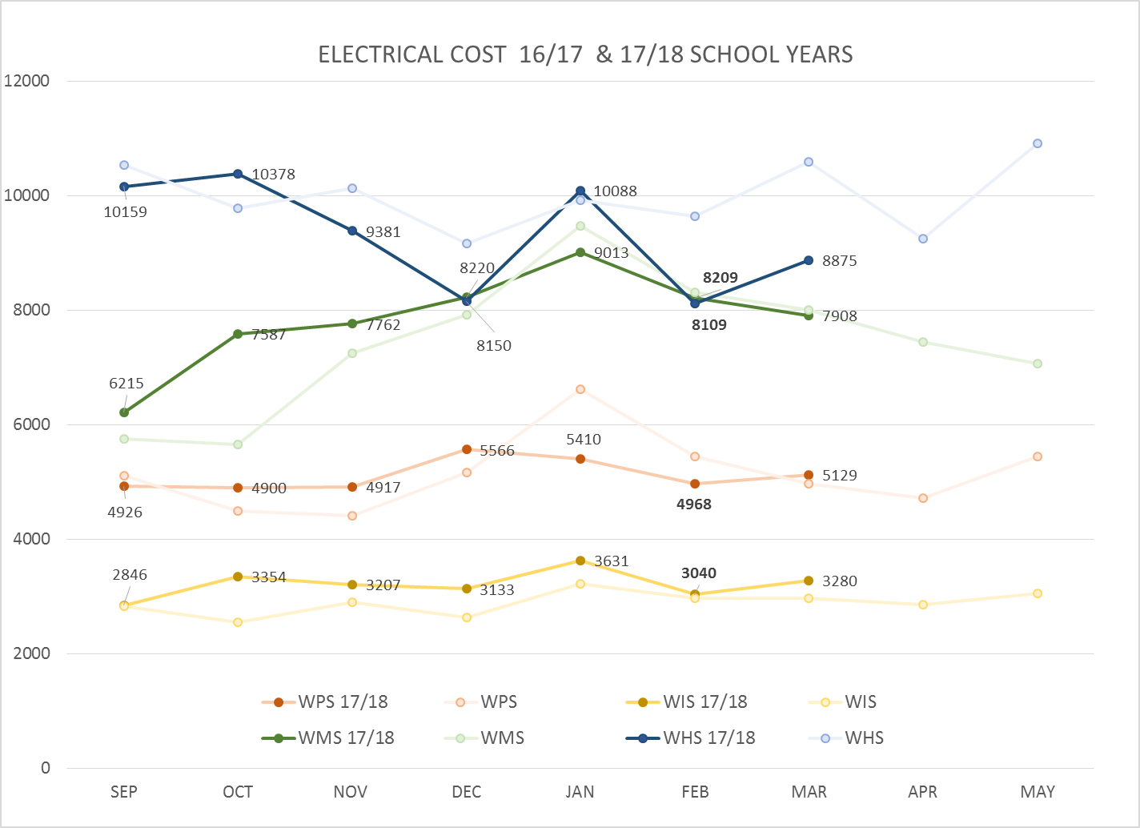
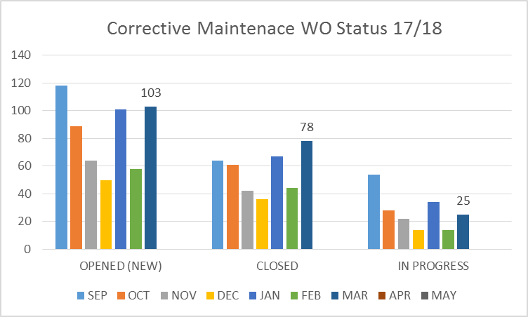
FACILITY CHARTS – POWER COST AND WORK ORDER STATUS

Slide 5
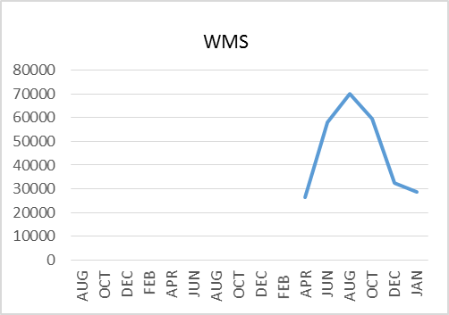
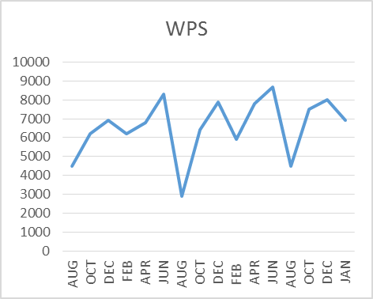
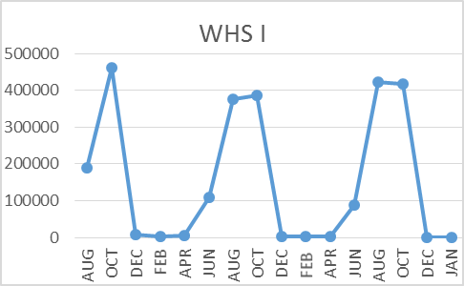
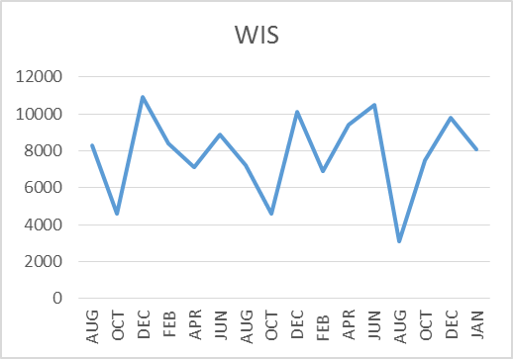
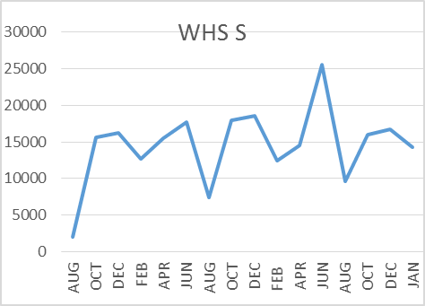
FACILITY CHARTS –
WATER USAGE
WHS, WIS, WMS, WPS
Water charts are updated every two
months. The next update to these charts
is in May 2018
The WMS chart includes 755 Park St. high and low flow, BO and Team High, PIT House, bus barn, athletic field and DO. All of these meters are totaled on the WMS graph; but, each data point is recorded separately, to aid in identifying leaks.

Slide 6
SAFETY REPORT
Accidents/Incidents
There were 2 student and 10 staff accidents/incidents for the month.
Staff Accidents/Incidents (10)
WPS - All staff incident were the result of student behavior at the primary school.
Student Accidents/Injuries (2)
WPS - Student went under play structure and cut head (3 staples).
WHS – Student fell on stairs hurt wrist.

Slide 7
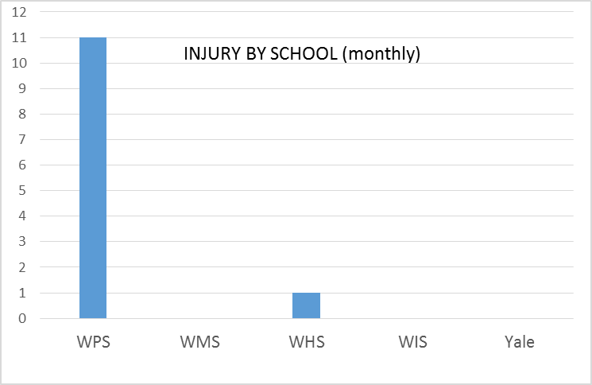
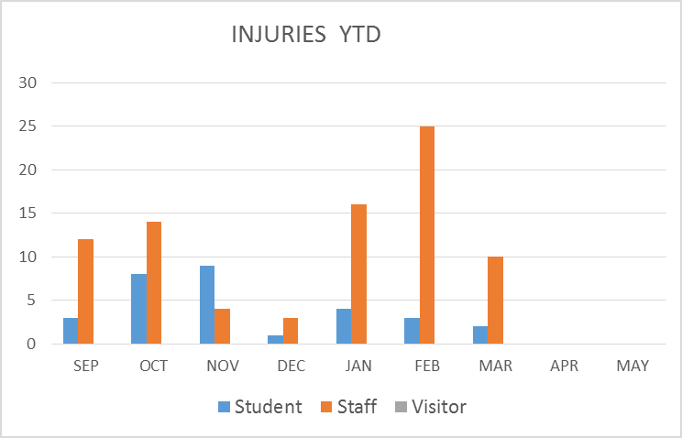
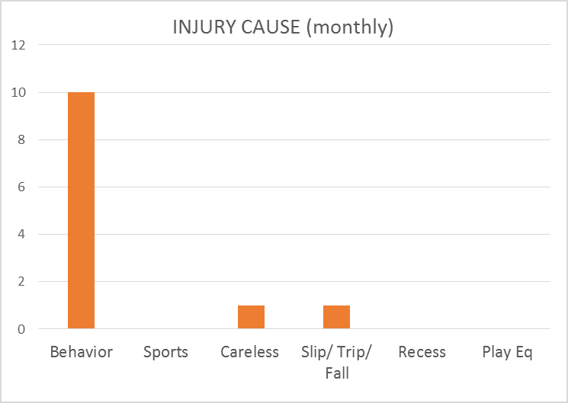
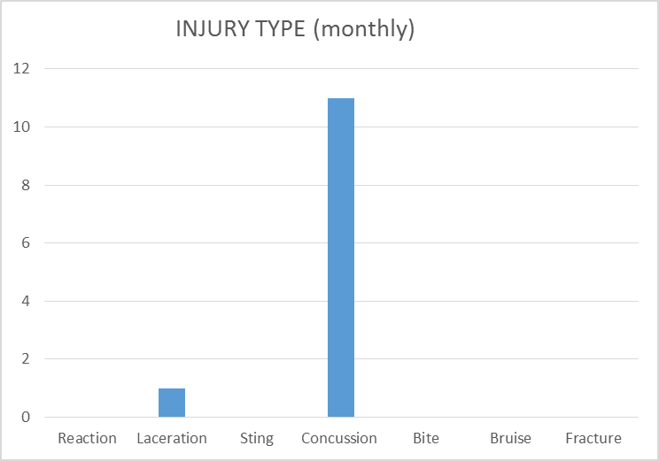
SAFETY CHARTS

